Slide 1
Is Network the Bottleneck of Distributed Training?
Zhen Zhang
Chaokun Chang, Haibin Lin, Yida Wang, Raman Arora, Xin Jin
Notes:
Hello everyone, this is Zhen Zhang.
Today I am going to present our recent work, "Is network the bottleneck of distributed training?"
This is joint work with Chaokun, Haibin, Yida, Raman, and Xin.

Slide 2

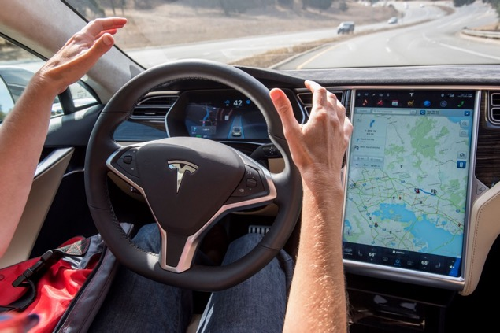
Deep learning applications
Alexa speech recognition
Google translation
Grammarly
Autopilot
…
Notes:
Recently, many intelligent systems are powered by Deep Learning techniques,
which greatly improves user experience.
Here are some examples, including Amazon Alexa, Google translate, Grammarly, Autopilot, etc.

Slide 3

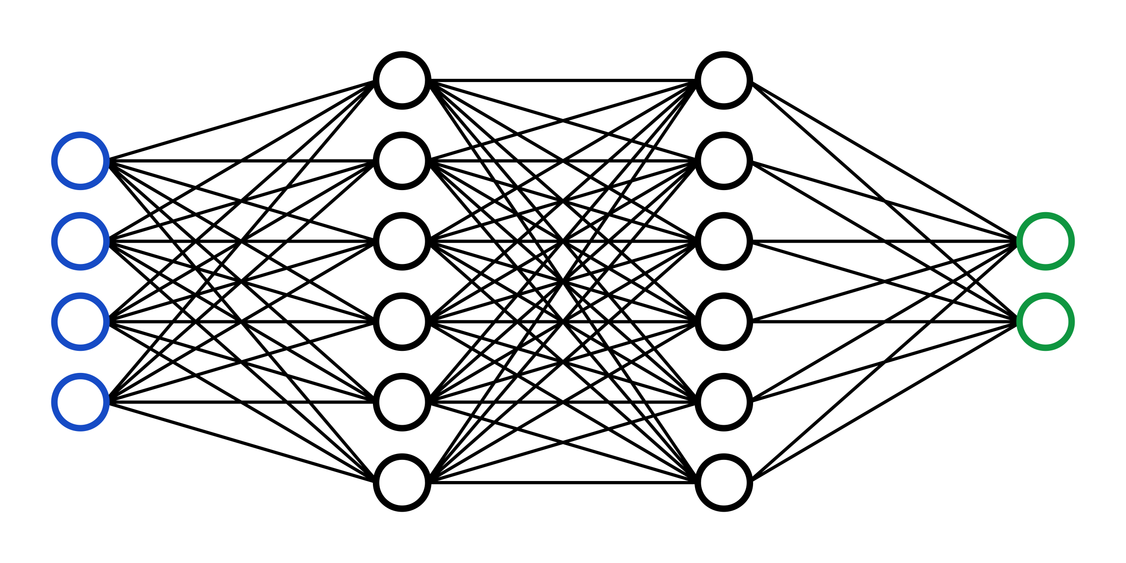
Deep learning training
Training is the most important step
One issue: time-consuming
Models are large
Datasets are large
1. Forward
2. Backward
Dog
Cat
Loss
Notes:
While before applying deep learning model into the production,
we must first train the deep learning model with some data.
The overall process of training mainly consists of two steps.
First, we feed a data sample into the model to get a prediction result.
We call this step as the forward computation in training.
After we get the prediction, for example, "Cat" here,
we compare it with the label "Dog" then generate the mismatch information as the loss.
Then we can start the second step,
the backward computation to update the weights of the deep learning model.
So that next time, when the model sees the same sample,
the model is going to predict it as "dog".
There is one issue in Deep learning training,
that the training process is time-consuming,
which is mainly due to two factors.
First, deep learning models are typically large.
For example, ResNet101 contains over 40 Million parameters.
Second, the datasets for training are also large.
Typically, we need millions of labeled images to train a well-performed computer vision model.

Slide 4
Distributed training
GPU-0
Distributed data parallel training
All-reduce
Parameter server
Distributed model parallel training
Layer-wise partition
D1
(the focus of this talk)
D
GPU-1
D2
GPU-0
GPU-1
D
Notes:
To speed up the training process,
people start using distributed systems for Deep Learning training,
which we call distributed training.
There are two big categories of distributed training.
Distributed data-parallel training is one of them.
In data-parallel training, each GPU gets a complete copy of the model.
Then we scatter the dataset onto GPUs for forward and backward,
then summing gradients among all GPUs for weights update.
There are two sub-categories in data-parallel training,
"all-reduce" based method and "parameter server" based method.
The difference is mainly on how do we sum gradients over all GPUs.
Another big category of distributed training is called distributed model parallel training.
In which, each GPU gets part of the model.
In this example, GPU-0 gets the first two layers of the model, GPU-1 gets the rest two layers.
Data is fed into GPU-0, which has the first few layers.
During the forward and the backward processes,
GPU-0 and GPU-1 need to exchange forward activations and backward gradients.
In this talk, we are going to focus on the "all-reduce" based method in data-parallel training.

Slide 5
Distributed training with all-reduce
Update weights
Forward
Loss
Backward
Sync gradients
Data-0
GPU-0
GPU-1
All-reduce
Forward
Loss
Backward
Sync gradients
Data-1
Update weights
Notes:
In this slide, let me introduce some brief details about all-reduce based
data-parallel to emphasize the differences comparing to training on a single GPU.
Take two GPUs as a showcase.
We first distribute the model onto two GPUs using broadcast.
Then we start to feed two disjoint datasets into two models independently.
Once we completed the forward and backward, we have an additional phase called "sync gradients".
Because we feed different parts of the dataset into models, and the gradients depend on data.
Thus, two models have different gradients that lead models to diverge.
The synchronization process guarantees two models have the same gradients for this round,
thus have the same weights for the next iteration.
Once the synchronization is done, we can start updating the model with obtained gradients.
The synchronization process and backward are typically pipelined to improve the synchronization efficiency, which we will talk later.

Slide 6
Scaling efficiency in distributed training
Ideal: scaling linearly
Reality: fail to achieve
Due to communication cost
Recent work on optimizing communication
Deep gradient compression [1]
In-network aggregation [2]
…
[1] Lin, Yujun, et al. "Deep gradient compression: Reducing the communication bandwidth for distributed training." arXiv preprint arXiv:1712.01887 (2017).
[2] Sapio, Amedeo, et al. "Scaling distributed machine learning with in-network aggregation." arXiv preprint arXiv:1903.06701 (2019).
Notes:
Since we go to the distributed system, the natural question to ask is the scaling efficiency.
Ideally, we want to achieve linear scaling. In the case that we using n GPUs to reduce the training time by n.
While in reality, most distributed training systems fail to achieve scaling linearly.
In common belief, this is mainly due to the cost of synchronization,
which involves communication across GPUs.
Thus, many recent papers propose methods for optimizing communication.
Two representative ones are deep gradient compression and in-network aggregation.
Deep gradient compression uses lossy compression to reduce the size of gradients for synchronization.
In-network aggregation uses programable switches for gradients synchronization.
And there are many other works.

Slide 7
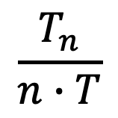
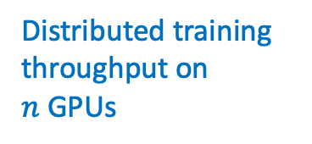
Our goals
Whether the network is the bottleneck?
What is the current scaling efficiency?
Is the network highly utilized?
What if the network is fully utilized?
Distributed training throughput on
$n$ GPUs
$$\frac{T_{n}}{n∙T}$$
Number of GPUs
Training throughput on
1 GPU
Notes:
In this project, our goal is to study whether the network is the bottleneck for distributed training.
Or more directly, whether the network is the bottleneck for communication.
To answer this question, we first investigated the current scaling efficiency in the AWS cloud.
Then, we checked the network utilization. In which, we found the network utilization is low.
Thus, a natural question to ask is what if the network is fully utilized.
To quantify the scaling efficiency, we define the scaling factor at the bottom.
Where T sub-n denotes the distributed training throughput on a cluster with n GPUs.
N denotes the number of GPUs involved in training.
T represents the training throughput on a single GPU.
When the factor equals to one, we achieve linear scaling.

Slide 8
Evaluation setup
Hardware
AWS p3dn.24xlarge instance: 8 x V100, 96 vCPUs, 100Gbps
Software
Horovod-0.18.2 with PyTorch-1.3.0
Workload
ResNet50, ResNet101, VGG16
Notes:
Before we start showing the evaluation results, here are the brief evaluation setups.
Aws p3dn.24xlarge instances are used in the evaluation.
Each instance has with 8 V100 GPUs, 96vGPUs and 100Gbps
Softwares we picked are horovod 0.18.2 and PyTorch 1.3.0.
Our evaluation workloads include Resnet50, resnet101, vgg16,
which are typical workloads in benchmarking distributed training.

Slide 9
What is the current scaling factor?
Fail to scale out linearly
Scaling factor vs. number of GPUs involved
Notes:
Here is the graph for showing the current scaling
efficiency with different number of GPUs involved.
We can see in all setups, the distributed training cannot achieve linear scaling.
In the 8 GPUs case, the synchronization is not over the network but on the NvLink or PCIe link.
Because all GPUs are on the same machine. Thus, it results in better scaling factors.
Once the setup includes multiple instances, the scaling factor drops quickly.
The interconnect links are 100Gbps networks.

Slide 10
The impact of network bandwidth on scaling factor
No benefits after 25Gbps
Scaling factor changes with bandwidth (ResNet50)
Notes:
Besides experimenting on default 100Gbps networks for scaling factors,
we also measured the scaling factor with different network bandwidths.
Here is the example for ResNet50.
Here we use the Linux tc command to control the network bandwidth.
As we increase the bandwidth from 1Gbps to 10Gbps, the scaling factor increases drastically.
However, all lines reach a plateau after 25Gbps.
This means the system can not benefit from a faster network.

Slide 11
Is the network highly utilized?
Low utilization of network bandwidth
Network utilization (recv)
Notes:
To validate the measurement results we measure the
network utilization of the servers by recording real-time network throughput.
As shown in this figure,
the network utilization is pretty low in high-speed networks with 40Gbps links or 100Gbps.

Slide 12
Is CPU the bottleneck?
CPU is not the bottleneck to saturate the bandwidth
CPU utilizations in different network bandwidth
Notes:
The low bandwidth utilization might due to the CPU bottleneck,
because our experiments we run are over TCP.
It is known that running TCP at high speed is CPU intensive.
However, as we can see in this CPU utilization figure,
CPU utilization hasn't exceeded 30%.
Thus, CPU is not the bottleneck to saturate network bandwidth.

Slide 13
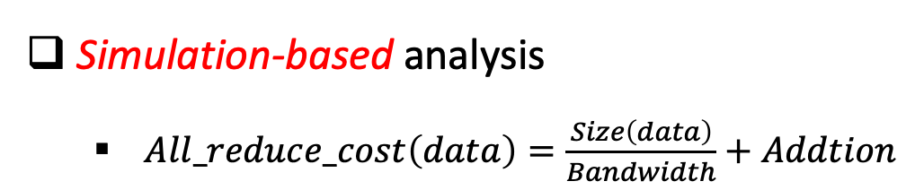
What if the network can be fully utilized?
Simulation-based analysis
$All_reduce_cost\left(data\right)=\frac{Size\left(data\right)}{Bandwidth}+Addtion$
Controlled
Forward
b_{n}
b_{n-1}
...
b₁
Backward
a_{n}
a_{n-1}
...
a₁
All-reduce
GPU-0
GPU-1
a_{n}
a_{n-1}
...
a₁
Forward
b_{n}
b_{n-1}
...
b₁
Notes:
As we see in previous measurement results, the network is not fully utilized.
So it is natural to ask what does scaling factor look like if the network can be fully utilized?
Thus, we further perform simulation-based what-if analysis in this project.
Let me briefly introduce the simulation process.
Let's consider distributed data-parallel on two GPUs.
The forward, backward and synchronization phases,
can be modeled as two threads.
The first thread takes care of forward and backward computations.
As shown here, we further decomposed the backward phase into small blocks.
Because gradients computations are completed layer by layer,
we can start gradient synchronization,
once backward computation for a certain layer or layer block is completed.
Thus, two backward and gradient synchronization are overlapped for better efficiency.
One iteration ends, when the last all-reduce operation completes.
The cost for each all-reduce operation is estimated via equation listed here.
We can control the bandwidth to simulate different network setups.

Slide 14
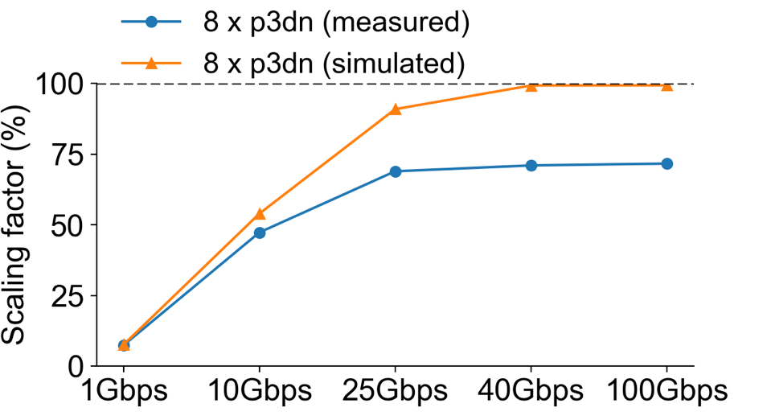
What-if analysis for different bandwidth
There are gaps to ideal results
Gaps to ideal
Scaling factor changes with controlled bandwidth (ResNet50)
Notes:
Now let's take a look at the results of our what-if simulation.
The figure here shows the what-if analysis result for
Resnet50 under different network bandwidth.
The blue line represents the real scaling factor on 8 p3dn
instances.
The orange line denotes the simulation results, which assume
network bandwidth can be fully utilized.
We can see there are gaps between real measurement and ideal results.

Slide 15
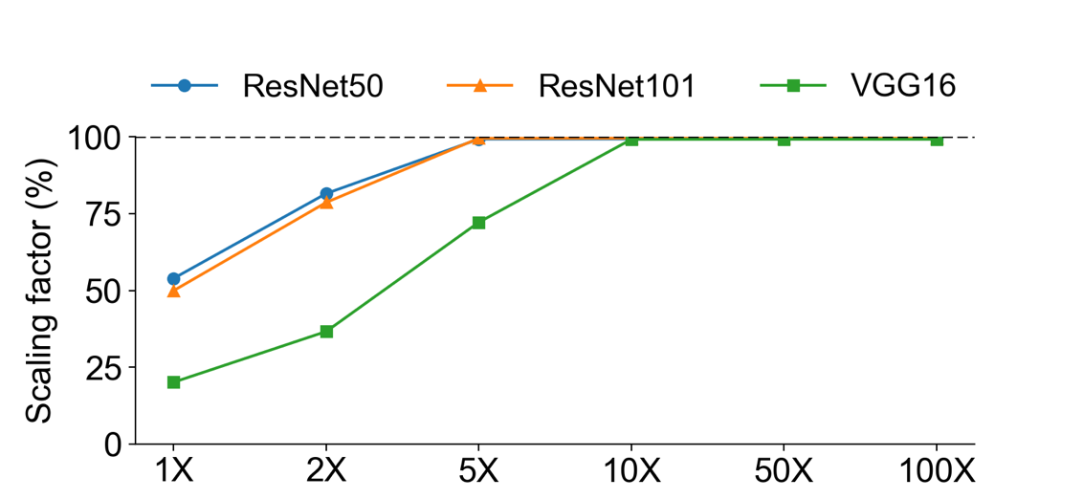
Is gradient compression useful?
10⨉ is good enough under 10Gbps networks
Effects of gradient compression
Notes:
Next, instead of changing the network in simulation,
we change the data size for gradient synchronization, to
simulate the effect of the gradient compression technique.
In this figure, we fixed the network bandwidth at 10Gbps,
and gradually increase the compression ratio of the gradients.
Basically, we divide the size of gradients by compression ratio to estimate the cost for gradient synchronization.
Different colored lines represent three different workloads we are simulating.
As shown here, even for very large models like VGG16,
which contains over 138 million parameters,
can achieve 100% scaling with compression ratio 10.

Slide 16
Is gradient compression useful?
No benefits under 100Gbps networks
Effects of gradient compression
Notes:
We also have results for 100Gbps network to show that
there is no requirement for gradient compression in
high-speed network like 100Gbps.
If we can fully utilize the bandwidth

Slide 17
Conclusions
Network is under utilized
Advocate high performance network transport for gradient communication
Gradient compression is beneficial in low speed networks
Up to 10⨉ compression is good enough under 10Gbps networks
Not useful under 100Gbps networks
Notes:
In conclusions
In distributed training, the network is underutilized.
And based on simulation results, we can see it is possible to
achieve linear scaling, if we can fully utilize high-speed networks.
Thus, we advocate the network community to develop
high-performance network transport for gradient communication.
On the other hand, the gradient compression is beneficial
in low-speed networks.
And we don't need a very large compression ratio like over 100.
up to 10x is good enough under 10Gbps network.
Lastly, gradient compression is not useful under 100Gbps networks.

Slide 18
Thanks!
Notes:
That's all for this talk.
Thanks for your patience.

